Slide 1
Python Programming
Session 3: (Functions)

Slide 2
Agenda:
1 | Defining and Using Functions
2 | Advanced Function Concepts
3 | Practical Examples

Slide 3
Defining and Using Functions

Slide 4
Defining and Using Functions
Functions are blocks of reusable code that perform a specific task. They help organize code into smaller, manageable pieces and can be used multiple times throughout a program.

Slide 5
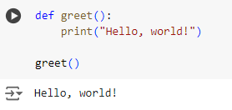
Defining and Using Functions
Basic Function Definition and Call
A function named greet() is defined with no parameters. When greet() is called, it prints "Hello, world!".

Slide 6
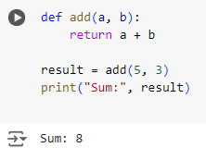
Defining and Using Functions
Function with Parameters
This function add(a, b) takes two parameters and returns their sum. Calling add(5, 3) results in 8 being printed.

Slide 7
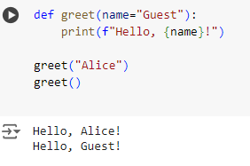
Defining and Using Functions
Function with Default Parameter Values
The function greet(name="Guest") has a default parameter value. If no argument is provided, it defaults to "Guest".

Slide 8
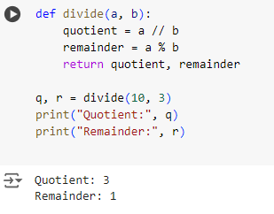
Defining and Using Functions
Function Returning Multiple Values
The divide(a, b) function returns both the quotient and remainder. These values are unpacked into q and r.

Slide 9
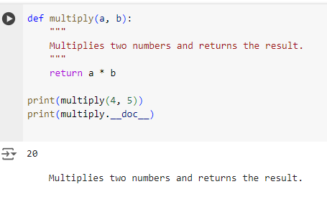
Defining and Using Functions
Using Docstrings for Function Documentation
This function multiply(a, b) includes a docstring to describe what the function does. The __doc__ attribute prints the docstring.

Slide 10
Advanced Function Concepts

Slide 11
Lambda Functions
Lambda functions are small, anonymous functions defined using the lambda keyword. They are used for short, simple operations.

Slide 12
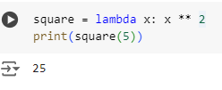
Lambda Functions
Basic Lambda Function
A lambda function is defined to square a number. The output is 25.

Slide 13

Lambda Functions
Lambda Function with Multiple Arguments
This lambda function takes two arguments and multiplies them. The output is 12.

Slide 14
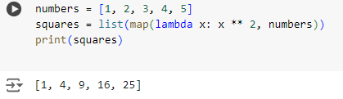
Lambda Functions
Using Lambda in map() Function
The map() function applies the lambda function to each element of the list. The result is [1, 4, 9, 16, 25].

Slide 15
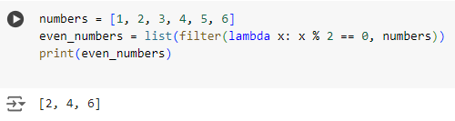
Lambda Functions
Using Lambda in filter() Function
The filter() function uses the lambda to keep only even numbers. The output is [2, 4, 6].

Slide 16
Recursive Functions
Recursive functions are functions that call themselves to solve a problem by breaking it down into smaller subproblems.

Slide 17
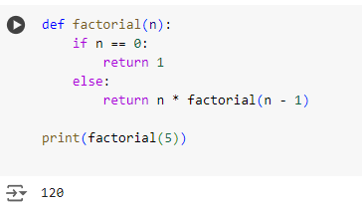
Recursive Functions
Calculating Factorial Using Recursion
The factorial(n) function calls itself with decremented values of n. It calculates 5! = 5 * 4 * 3 * 2 * 1 = 120.

Slide 18
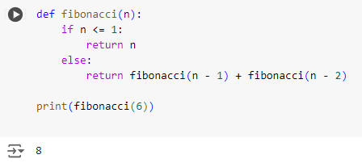
Recursive Functions
Fibonacci Sequence Using Recursion
This function calculates the Fibonacci number at position n by summing the previous two Fibonacci numbers. The output is 8.

Slide 19
Higher-Order Functions
Higher-order functions are functions that can take other functions as arguments or return them as results.

Slide 20
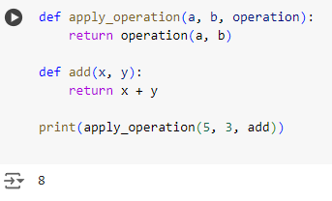
Higher-Order Functions
Using a Function as an Argument
The apply_operation(a, b, operation) function takes another function (add) as an argument and applies it. The output is 8.

Slide 21
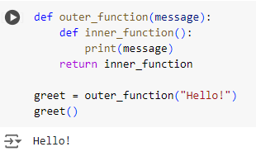
Higher-Order Functions
Returning a Function from Another Function
The outer_function() returns an inner_function that prints a message. When greet() is called, it prints "Hello!".

Slide 22
Practical Examples

Slide 23
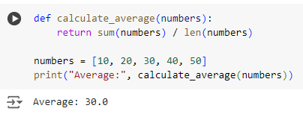
Calculating Average of Numbers Using Functions
Calculating Average of Numbers Using Functions
This function calculates the average of a list of numbers. The output is 30.0.

Slide 24
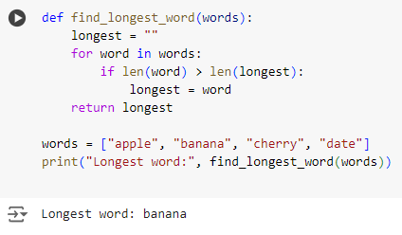
Calculating Average of Numbers Using Functions
Finding the Longest Word in a List
This function iterates over a list of words and returns the longest one. The output is "banana".

Slide 25
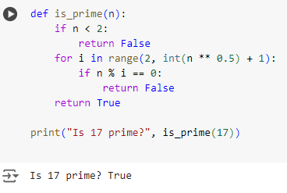
Calculating Average of Numbers Using Functions
Checking if a Number is Prime
The is_prime(n) function checks if a number is prime by testing divisibility up to its square root. The output is True.

Slide 26
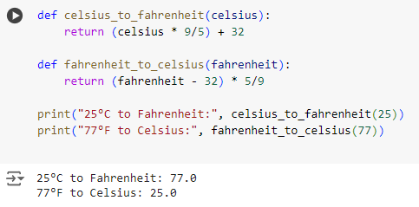
Calculating Average of Numbers Using Functions
Converting Temperature Units
Two functions convert temperatures between Celsius and Fahrenheit. The output is 77.0 and 25.0.

Slide 27
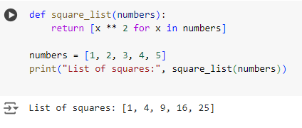
Calculating Average of Numbers Using Functions
Generating a List of Squares Using List Comprehension and Functions
The function square_list(numbers) uses list comprehension to generate a list of squares for the given input list. It iterates over each number, squares it, and creates a new list with these squared values. The output is [1, 4, 9, 16, 25].

Slide 28
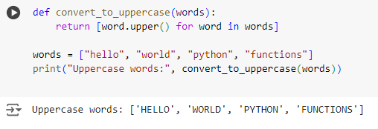
Calculating Average of Numbers Using Functions
Converting a List of Strings to Uppercase
The function convert_to_uppercase(words) uses list comprehension to iterate over each word in the input list, converting each word to uppercase. The output is ['HELLO', 'WORLD', 'PYTHON', 'FUNCTIONS'].

Slide 29
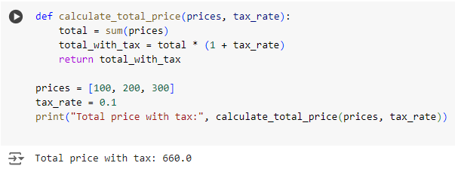
Calculating Average of Numbers Using Functions
Calculating the Total Price Including Tax
The function calculate_total_price(prices, tax_rate) calculates the total price of items in the list and then applies the tax rate. The output is 660.0.

Slide 30
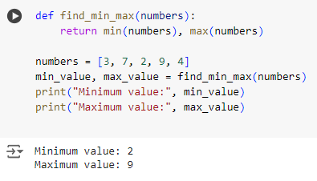
Calculating Average of Numbers Using Functions
Finding the Minimum and Maximum Values in a List
The function find_min_max(numbers) uses the built-in min() and max() functions to find the smallest and largest numbers in the input list. The output is 2 (minimum) and 9 (maximum).

Slide 31
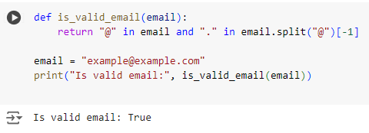
Calculating Average of Numbers Using Functions
Checking if a String is a Valid Email Address
The function is_valid_email(email) checks if a given string contains "@" and a "." after the "@", which are basic checks for a valid email format. The output is True.

Slide 32
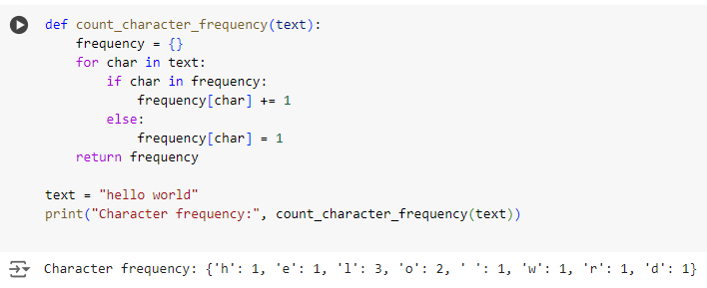
Calculating Average of Numbers Using Functions
Counting the Frequency of Each Character in a String
The function count_character_frequency(text) counts the occurrences of each character in the input string and returns a dictionary with characters as keys and their frequencies as values. The output is {'h': 1, 'e': 1, 'l': 3, 'o': 2, ' ': 1, 'w': 1, 'r': 1, 'd': 1}.

